Slide 1


v
Uniting Europe's Energy, Today
Secretariat’s assessment of the
2025 NECPRs
Main elements and findings
June 2026

Slide 2
Assessment of NECPs
Assessment of progress
Mandated by the Governance Regulation 2018/1999
Article 13: Assessment of NECPs - Secretariat shall assess, whether targets are sufficient for the Energy Community’s 2030 targets and whether NECPs comply with structure and content laid out in the Governance Regulation.
Article 29: Assessment of progress - By 31 October 2025 and every two years thereafter, the Secretariat shall assess the progress made by each Contracting Party towards meeting its objectives and implementing the policies and measures set out in NECPs.

Slide 3
NECPs and integrated progress reports
Timeline
Draft NECPs submitted to EnCS
Adopted NECP notified to EnCS
1st integrated progress reports submitted
 | 30-Jun-23 |  |  |  | 30-Jun-24 |  |  | 15-Mar-25 |  |  | 31-Dec-25
 |  |  | Accommode EnCS’ recommendations |  |  | Start NECP implemen-tation & monitoring
Start of EnCS’ stocktaking

Slide 4

Assessment of progress
Criteria
Completeness: Did Contracting Parties report all mandatory information?
Quality: Is reported information credible and aligned with NECPs?
Actual progress: Do Contracting Parties progress towards the 2030 energy and climate targets?

Slide 5
Completeness
Contracting Parties did not provide the full set of reports/ information outlined under Implementing Regulation 2022/2299.
Recurring gaps:
Annex I: GHG emissions, here especially those information to be pre-/post-filled from submissions under other reporting obligations
Annex III: Adaptation
Annexes IX-XIV: Policies and measures, including the assessment of their progress and contributions

Slide 6


Quality of reported information
Despite the significant gaps, progress reports provide a rich set of information and data about the current state of the energy system and economy.
.
Information is not always provided in the expected fields/ tables, but elsewhere.
Quality
.
Reported information is not always aligned with NECPs (policies and measures, targets).
Contracting Parties cooperated closely with EEA and DG ENER throughout the reporting process (technical guidance, trainings, QA/QC).
.
1

Slide 7


Progress to date
In their first integrated energy and climate progress reports, Contracting Parties reported on a period (2022-2023), when NECPs were still under development.
Thus, the reported figures can only reflect the starting point of NECP implementation.
Still, some Contracting Parties already seem to be on good track to achieve some of their 2030 targets.
Uniting Europe's Energy, Today
7

Slide 8
Progress to date
National greenhouse gas emission targets for 2030 and indicative milestones for 2040 and 2050, [Mt CO2eq]
 | Targets per 2022/02/MC-EnC | Targets and Milestones reported under Implementing Regulation 2022/2299 Annex I, Tables 1-4
 | 2030 | 2030 | 2040 | 2050
Albania | 12,00
Bosnia-Herzegovina | 15,65
Georgia | 20,50
Kosovo* | 8,95 | 8,95 | 7,00 | Climate neutral economy
Moldova | 9,10
Montenegro | 2,42
North Macedonia | 2,20
Serbia | 47,82 | 47,77 | 36,10
Ukraine | 309,00 | 320,42 |  | Climate neutral energy sector

Slide 9
Progress to date
Actual GHG emissions 2014-2022/2023, linear trends based on 2014-2022/2023 and linear trajectories towards achieving the 2030 GHG targets, [Mt CO2eq]
Start of NECP implementation in mid-2024

Slide 10
Progress to date
Share of renewable energy in gross final energy consumption by Energy Community Contracting Party [%] 2021-2023 compared to targets for 2020 and 2030
Start of NECP implementation in mid-2024

Slide 11
Progress to date
Primary energy consumption per Energy Community Contracting Party [Mtoe], historic data (2014-2023) and indicative trajectories towards achieving 2030 targets (2024-2030)
Start of NECP implementation in mid-2024

Slide 12
Policies and measures
Assessment of NECPs | Assessment of progress
Seven Contracting Parties adopted NECPs, all coming forward with large sets of policies and measures. | Four Contracting Parties reported on policies and measures under Annexes IX-XIII of Impl. Reg. 2022/2299.
Contracting Parties described policies and measures comprehensively in terms of their objective, timeframe, sectoral scope and responsible entities. | In parts, reported information differs from the policies and measures listed in NECPs in terms of number, description or objective.
Policies and measures are described rather qualitatively without quantifying their expected output or contribution to (sectoral) targets (exemption: North Macedonia). | Across submissions, quantitative information on ex-ante/ ex-post emission reductions, cost and benefits is missing.

Slide 13
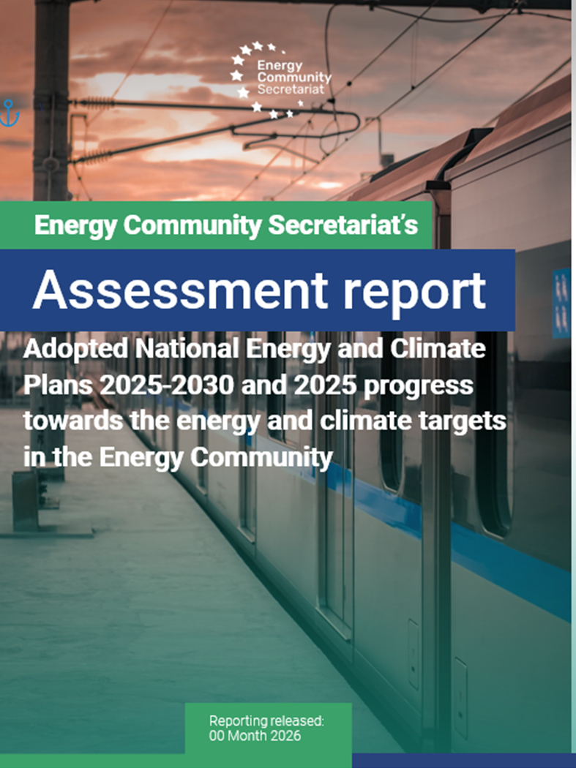
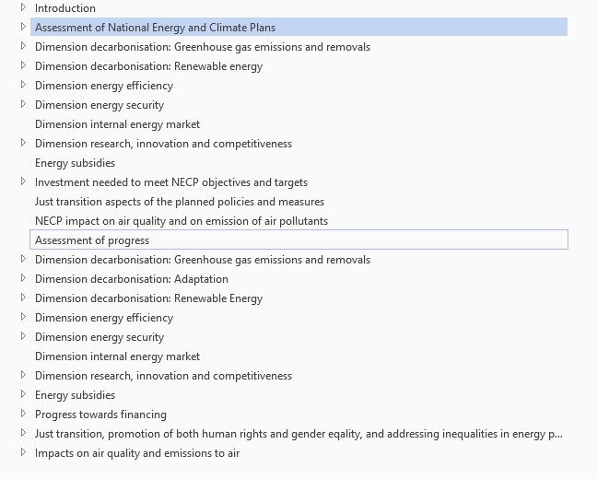
Coming soon

Slide 14




THANK YOU!
energy-community.org
Energy Community Secretariat
Am Hof 4, Level 5, 1010 Vienna, Austria

